Slide 1
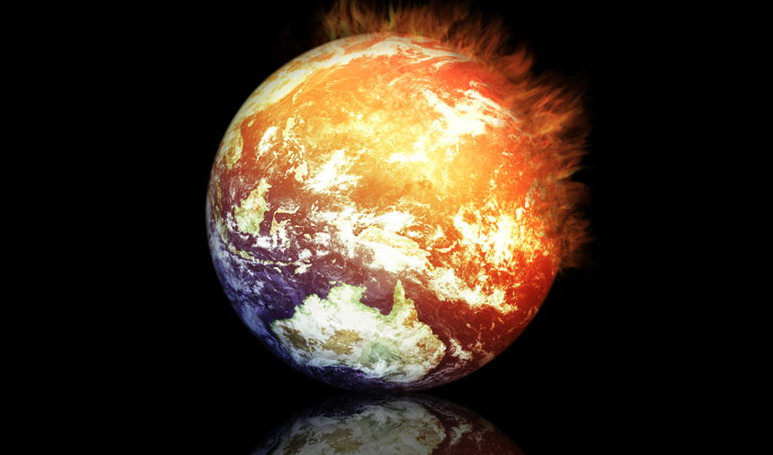
Isaiah 2:6–4:1
Why the Heat?
Dr. Rick Griffith, Crossroads International Church Singapore Bible College • BibleStudyDownloads.org

Slide 2
Sometimes God doesn't make sense.

Slide 3
Sometimes God doesn't make sense.
Notes:
Do you think God always makes sense?
• Why does God allow ISIS to rampage the Middle East?
• Why doesn't God preserve the kids of godly parents?
• Shouldn't life be easier for us who love the Lord? Last week a gunman in Oregon murdered those who claimed to be Christians.

Slide 4
Bible Q & A
Notes:
The Bible often asks sensible questions—questions about God not making sense:
• Why are wicked people so rich? Psalms 37 and 73 answer this.
• Why does God use people who are even wickeder than us to discipline us? The book of Habakkuk answers this one.
• Why do evil folks often live long but righteous people die young? Ecclesiastes answers this.
Today we'll tackle another of these hard questions…

Slide 5
Why would God make life hard for his own people?

Slide 6
The Assyrian Threat
454
Assyrian Expansion
Nineveh
Mediterranean
Sea
Aram
Israel
Judah
700s BC
Persian
Gulf
Egypt
Notes:
6
Things were bad in Judah and they were going to get worse.

Slide 7
Isaiah 1
The court case against Israel

Slide 8
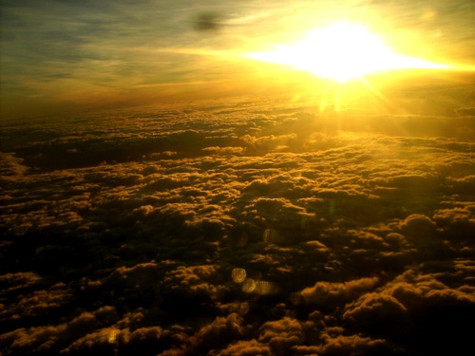
Christ's Future Rule in Jerusalem
Isaiah 2:1-5; 4:2-6
Notes:
The "court case against Israel" (Isa. 1) is followed by God's promise of blessing on Millennial Jerusalem (2:1-5). Just after today's text in 2:6–4:1 is another passage on Millennial Jerusalem (4:2-6), so today we look at the stuff in the middle.

Slide 9
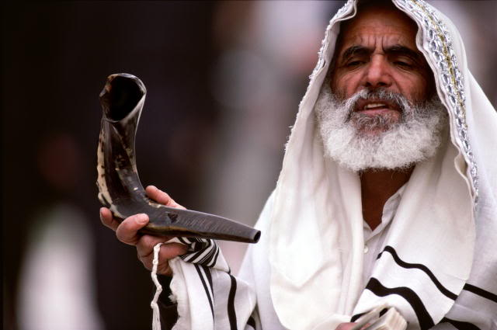
Two Key Kingdom Texts:
Isaiah 2:1-5
Isaiah 4:2-6
Notes:
The "court case against Israel" (Isa. 1) is followed by God's promise of blessing on Millennial Jerusalem (2:1-5). Just after today's text in 2:6–4:1 is another passage on Millennial Jerusalem (4:2-6), so today we look at the stuff in the middle.

Slide 10
Why would God make life hard for his own people?
Two reasons…
Notes:
Why would God make life hard for his own people? The first reason he allows things to get bad is…

Slide 11
I. Our pride leads us to self-confidence (2:6-22).
Notes:
We need humility that shows faith in God—not in us.

Slide 12
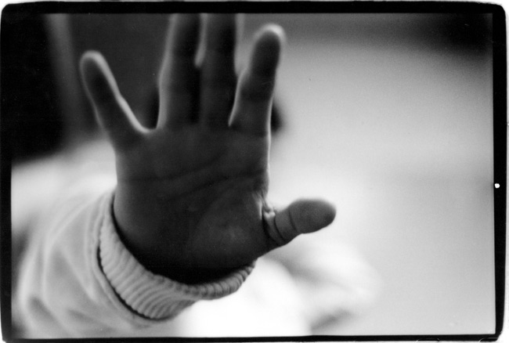
"For the LORD has rejected his people, the descendants of Jacob" (2:6 NLT).

Slide 13
Contrasting Two Key Covenants
51
Abrahamic
Mosaic
Gen. 12:1-3
Exod. 20–31
“I will”
“If you will”
Unconditional
Conditional

Slide 14
"For the LORD has rejected his people, the descendants of Jacob, because they have filled their land with practices from the East" (2:6 NLT).

Slide 15
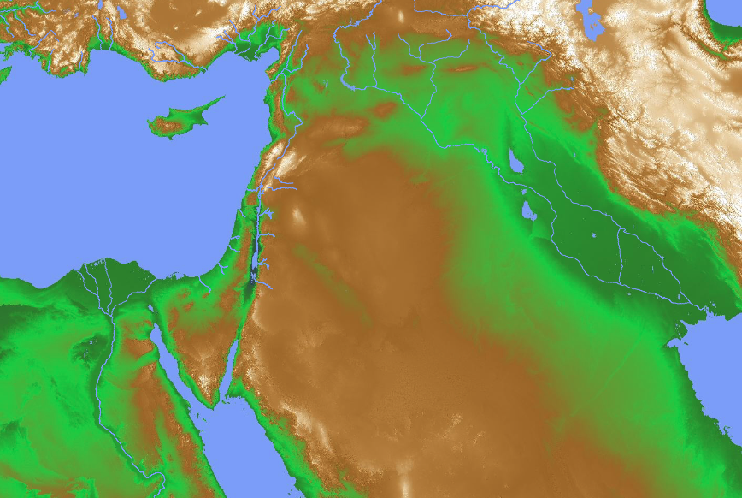
The East
28
Assyria
Syria (Isa. 9:12)
India
Notes:
Judah followed Eastern Religions (2:6).
Who were these eastern people (2:6b)?
Some say they were Assyrians.
Isaiah 9:12 refers to the Arameans (Syrians) as "from the east" since they had migrated there from Mesopotamia.
Ultimately, these eastern concepts in both Syria and Assyria came from teachings that had migrated from even farther east as Hinduism spread from India.
What kind of eastern practices did Judah follow (2:6b)?
Isaiah doesn't spell out these practices specifically.
Even the word "superstitions" (NIV) or "practices" (NLT) or "influence" (NAU) must be supplied, as it is not in the Hebrew text.

Slide 16
Eastern Thought
Notes:
Do you have any association with eastern philosophy?
Do you practice yoga, thinking it is only an exercise? In reality, we know yoga is a Hindu practice to connect the human spirit with Brahmin, the high Hindu god. The idea is that through relaxation we can become one with this "god," and discover in ourselves that we are god!

Slide 17
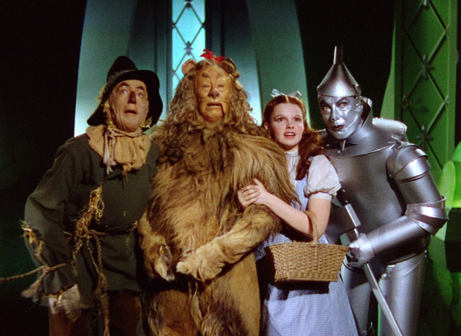
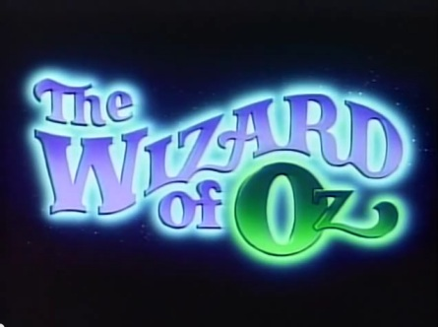
The Wizard of Oz
Notes:
Do you watch movies that encourage you to place your confidence in yourself rather than God? This is an eastern practice.
Such movies have been around since The Wizard of Oz—a film that teaches that there is no such wizard who controls events. Rather, the lion has the courage in himself, the scarecrow can find confidence in himself alone, and the tin man already has a heart so he doesn't need some higher power to give him one.
The only sensible one in the movie is Dorothy, who rebukes three men for not being man enough.
Now all movies seem to promote the idea of women who tap into their own power and rule over men who don't tap into their own strength. When was the last time you saw a woman rescued by a man? No, she is a warrior right there along with the men, showing them that they can have as much self-confidence as she has—all an eastern idea.

Slide 18
Women

Slide 19
Women

Slide 20
"For the LORD has rejected his people, the descendants of Jacob, because they have filled their land with practices from the East, and with sorcerers, as the Philistines do" (2:6 NLT).
Notes:
The word for "divination" literally means "to practice witchcraft or soothsaying."

Slide 21
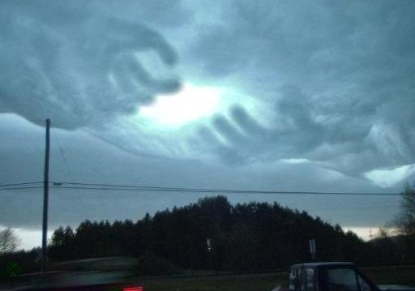
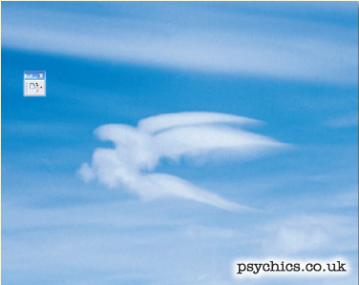
The Divination Cloud
Notes:
The noun form means "cloud-mass" of "cloud of incense"

Slide 22
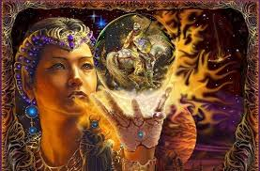
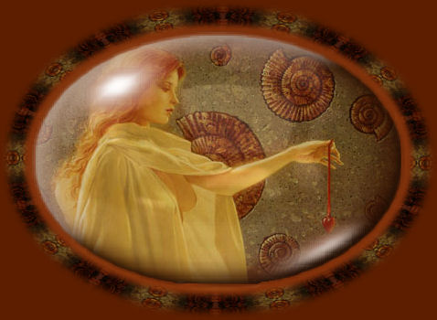
The Divination Cloud
Notes:
formed when incense makes a cloud.
In that cloud the Philistine witch would supposedly see the future.

Slide 23
Divination for Beginners – One Day Workshop at Mosman Community College, Australia Saturday 27th July 2013
Notes:
Community colleges now offer courses in divination.
http://ruthiephillips.com/updates/divination-for-beginners-mosman-community-college-saturday-27th-july-2013/
Accessed 11 Oct 2015

Slide 24
"For the LORD has rejected his people, the descendants of Jacob, because they have filled their land with practices from the East, and with sorcerers, as the Philistines do. They have made alliances with pagans" (2:6 NLT).

Slide 25
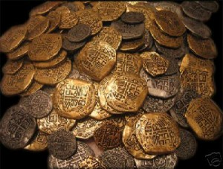
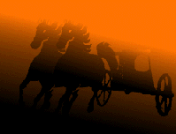
"Israel is full of silver and gold; there is no end to its treasures. Their land is full of warhorses; there is no end to its chariots" (2:7 NLT).

Slide 26
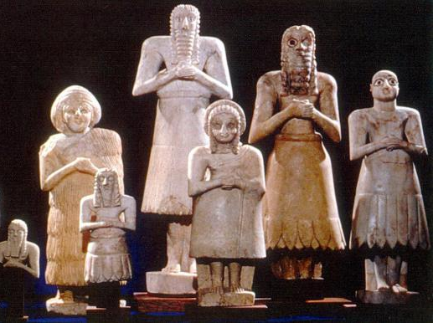
"Their land is full of idols; the people worship things they have made with their own hands" (2:8 NLT).

Slide 27
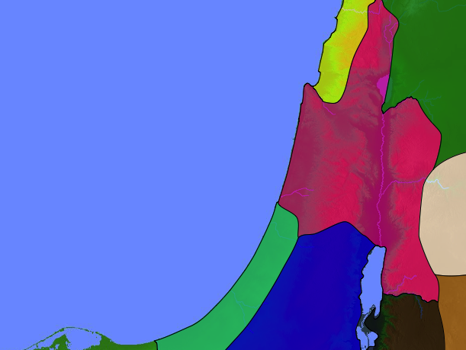
Ahab & Jezebel brought Baal worship to Israel
Importing Paganism...
Dan
Baal
Jeroboam set up calf idols at Bethel and Dan
Bethel
Jerusalem

Slide 28
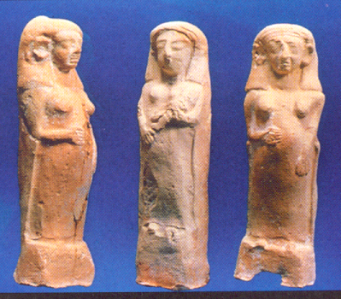
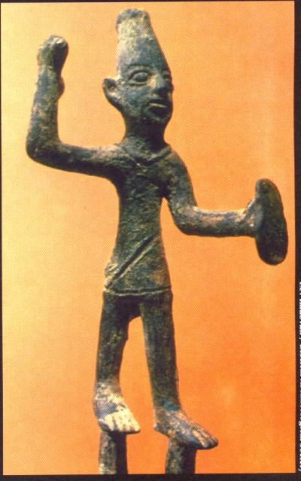
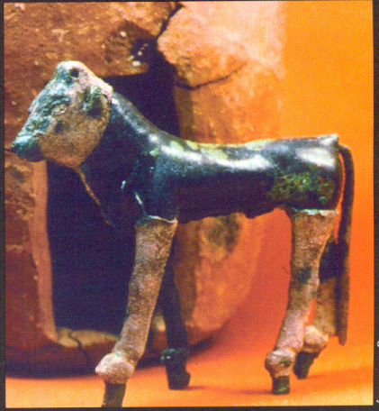
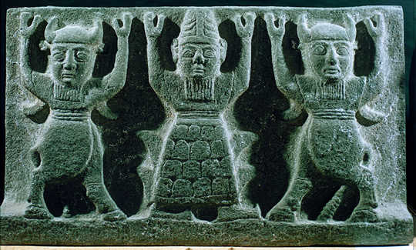
What is the Appeal of Idols?
248
Life Application Bible, 575
Power – We do not need to answer to a greater authority
Pleasure – Idols can be manipulated to what we want them to be / do
Passion – We deify pleasure, materialism
Praise & Popularity – We appease these gods instead of sacrifice of our lives to God (Rom. 12:1)

Slide 29
"Christian" Idolatry
Notes:
We worship our methods—yoga in the church, growth strategies, etc.

Slide 30
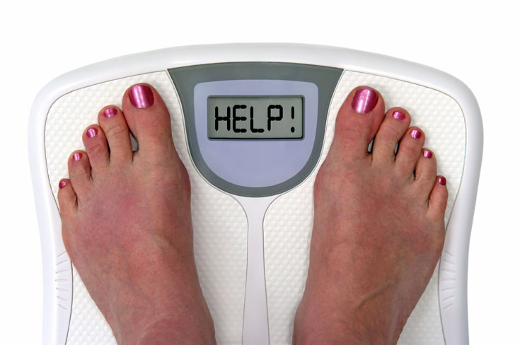
"Christian" Idolatry
Notes:
We worship our bodies—fitness, diets

Slide 31
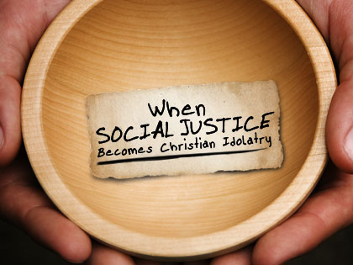
"Christian" Idolatry
Notes:
We worship our autonomy—abortion, democracy

Slide 32
God's response to Judah's trust in herself would be to humble the nation both in the near Babylonian invasion and the distant Tribulation judgments (2:9-22)
Notes:
Notice how many references appear here to humility verses pride, to being brought low compared to exalting oneself. I counted 26 times! But God will be exalted—I counted 10 times!

Slide 33
Isaiah's View of the Future
442
New Heavens & New Earth
Christ's Second Coming to Reign in Millennium
Christ's First Coming to Suffer (AD 33)
Exile & Return (586 BC)
Isaiah's Time (700 BC)
Adapted significantly from Salem Kirban, Charts on Revelation (1979), 49
Notes:
When would this humbling take place? Isaiah primarily writes the southern nation of Judah, as the people were looking to the north while God judges that northern nation of Israel for its idolatry. Isaiah saw the future but only as one entire event.
The question remained whether they would stop doing the same kinds of practices—or would they continue in them and also be judged?
They continued, so 21 years after the fall of the north, 46 cities of the south were ravaged by the Assyrians—all the way up to Jerusalem, where the conquest finally halted under godly king Hezekiah.
Having a godly king isn't enough, though. The people themselves are responsible for their own lives. Would they repent?

Slide 34
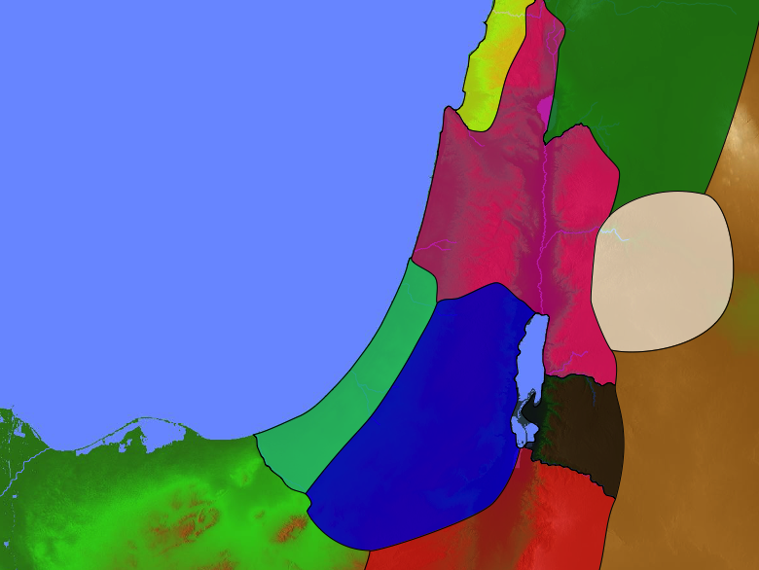
Divided Kingdom
140
Phoenicia
Aram
1 Kings 12–2 Kings 17
Israel
Ammon
Philistia
Judah
Moab
Egypt
Edom

Slide 35
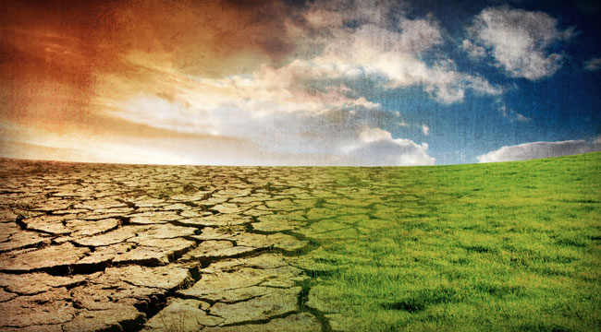
"In that day…"
452
343
Isaiah 2:17, 20; 3:7, 18; 4:1-2
Judgment
Salvation
Notes:
However, he wisely didn't tell them exactly when it would occur. Isaiah is like many prophets who only saw the future—but not how far in the future! This is how the phrase "in that day" functions (Isa. 2:17, 20; 3:7, 18; 4:1–2).

Slide 36
God judges our pride and self-sufficiency too.

Slide 37
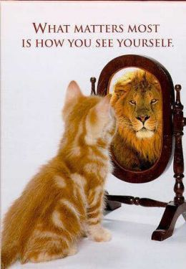
The Self-Esteem Craze
WHAT MATTERS MOST IS HOW YOU SEE YOURSELF

Slide 38
Self Confidence

Slide 39
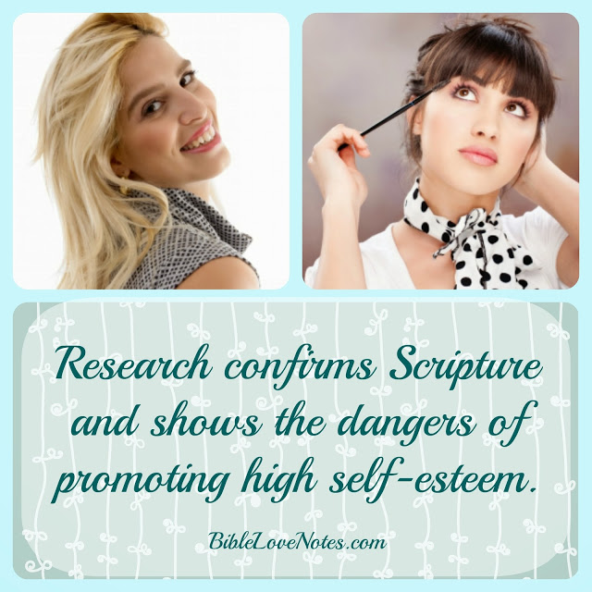
The Self-Esteem Craze
Notes:
Secular Studies Confirm God's Word Quotes from secular authorities discussing the promotion of high self-esteem http://biblelovenotes.blogspot.sg/2009/09/SelfEsteem7.html
Accessed 10 October 2015
"If you read only one of my 7 part series on the Dangers of High Self-Esteem, this is the one to read. In this series (Parts 1, 2, 3, 4, 5, 6) I've talked about the way self-esteem philosophy has infiltrated the church and twisted the meaning of a few Scripture passages while ignoring the overall message of Scripture. This alone is enough evidence to reject the popular self-esteem teachings. However, the "self-esteem experiment" in America also provides secular evidence that agrees with God's Word, evidence that few Americans are heeding. I offer it below as one final argument against building our children's self-esteem. But before I do that, I want to quote one of the most direct statements about high self-esteem found in Scripture:
"But mark this: There will be terrible times in the last days. People will be lovers of themselves, lovers of money, boastful, proud, abusive, disobedient to their parents, ungrateful, unholy, without love, unforgiving, slanderous, without self-control, brutal, not lovers of the good, treacherous, rash, conceited, lovers of pleasure rather than lovers of God— having a form of godliness but denying its power. Have nothing to do with such people."
2 Timothy 3:1-5
Below you can read how this passage is being fulfilled in America. I have interspersed Scripture references (in blue) along with these documented quotes from secular authorities.
1. Dangers of Self-Esteem Conclusion of study conducted by Ohio State University and the Department of Energy's Brookhaven National Laboratory. source at bottom "American society seems to believe that self-esteem is the cure all for every social ill, from bad grades to teen pregnancies to violence. But there has been no evidence that boosting self-esteem actually helps with these problems. We may be too focused on increasing self-esteem. … The problem isn't with having high self-esteem; it's how much people are driven to boost their self-esteem. When people highly value self-esteem, they may avoid doing things such as acknowledging a wrong they did." The Bible also says that those who are good in their own eyes don't have a realistic view of their own sins or needs (Luke 18:9-14). 2. Does High Self-Esteem Cause Better Performance, Interpersonal Success, Happiness, or Healthier Lifestyles? by Roy F. Baumeister, Florida State University; Jennifer D. Campbell, University of British Columbia; Joachim I. Krueger, Brown University; Kathleen D. Vohs, University of Utah
"Popular wisdom in the age of self-esteem holds that loving oneself is a prerequisite for loving others ... Efforts to boost self-esteem in schools, homes, and elsewhere would be well justiﬁed if they resulted in signiﬁcant improvements in how people got along with one another. The evidence suggests that the superior social skills and interpersonal successes of people with high self-esteem exist mainly in their own minds. People with high self-esteem claim to be more popular and socially skilled than others, but objective measures generally fail to conﬁrm this and in some cases point in the opposite direction..."
"Always praising and never criticizing may feel good to everyone concerned, but the data we have reviewed do not show that such an approach will produce desirable outcomes...Using self-esteem as a reward rather than an entitlement seems most appropriate to us. To be sure, there may still be a place for unconditional positive regard, such as when a parent shows love for a child independent of achievement. But when achievement or virtue is involved, self-esteem should be conditional upon it. A favorable view of self should be promoted on the basis of performing well and behaving morally. By the same token, we think it appropriate and even essential to criticize harmful or unethical behavior and lazy or deﬁcient performance, without worrying that someone's self-esteem might be reduced." Constructive criticism and strong rebukes are a part of love. Lest we doubt that, look at the words of Jesus to his disciples whom He loved (Mark 8:33).
"The praise-only regimen of the self-esteem movement is ultimately no more effective for learning than the criticism-only regimen of the previous era... Praising all the children just for being themselves, in contrast, simply devalues praise and confuses the young people as to what the legitimate standards are. In the long run, if such indiscriminate praise has any effect on self-esteem, it seems more likely to contribute to narcissism or other forms of inﬂated self-esteem than to the kind of self-esteem." Jesus said we should expect no special praise for doing what we are supposed to do (Luke 17:7-10). 3.The Trouble With Self-Esteem Lauren Slater, NY Times "Last year alone there were three withering studies of self-esteem released in the United States, all of which had the same central message: people with high self-esteem pose a greater threat to those around them than people with low self-esteem and feeling bad about yourself is not the cause of our country's biggest, most expensive social problems. ... Shifting a paradigm is never easy. More than 2,000 books offering the attainment of self-esteem have been published; educational programs in schools designed to cultivate self-esteem continue to proliferate, as do rehabilitation programs... Self-esteem, as a construct, as a quasi religion, is woven into a tradition that both defines and confines us as Americans... Perhaps, as these researchers are saying, pride really is dangerous, and too few of us know how to be humble... psychology and psychiatry are predicated upon the notion of the self, and its enhancement is the primary purpose of treatment... Maybe self-control should replace self-esteem as a primary peg to reach for."
There are many secular authorities who are still singing the praises of high self-esteem. They may even have "evidence" to back up their claims (studies can be based on poor research methods). So who should we believe? I believe we should trust the Bible first and then those authorities (like the ones above) who agree with what Bible teaches. Praising people for everything and for nothing makes them arrogant and addicted to the praise of men. Let's treat children as the Bible commands, neither expecting too much of them nor too little. We should love them always, punishing them when they're bad and praising them when they do something exceptional.
I would love to have your feedback on this series. Has it helped you reject some self-esteem teachings you previously accepted? Has it been helpful? Do you still have questions? Please leave a comment and let me know about this or any of the other posts in this series. Thanks! The whole series: Part 1: The Dangers of Promoting High Self-Esteem Part 2: Self-Esteem's Twisted Proverb Part 3: Self-Esteem's Twisted Words of Christ Part 4: Self-Esteem's Twisted Psalm Part 5: The Old Testament Refutes Self-Esteem Philosophy Part 6: Godly Nurture Does Not Promote High Self-Esteem Part 7: Secular Studies Agree with the Bible

Slide 40
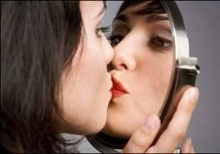
The Self-Esteem Craze
"But mark this: There will be terrible times in the last days. People will be lovers of themselves, lovers of money, boastful, proud, abusive, disobedient to their parents, ungrateful, unholy, without love, unforgiving, slanderous, without self-control, brutal, not lovers of the good, treacherous, rash, conceited, lovers of pleasure rather than lovers of God— having a form of godliness but denying its power. Have nothing to do with such people."
2 Timothy 3:1-5
Notes:
Secular Studies Confirm God's Word Quotes from secular authorities discussing the promotion of high self-esteem http://biblelovenotes.blogspot.sg/2009/09/SelfEsteem7.html
Accessed 10 October 2015
"If you read only one of my 7 part series on the Dangers of High Self-Esteem, this is the one to read. In this series (Parts 1, 2, 3, 4, 5, 6) I've talked about the way self-esteem philosophy has infiltrated the church and twisted the meaning of a few Scripture passages while ignoring the overall message of Scripture. This alone is enough evidence to reject the popular self-esteem teachings. However, the "self-esteem experiment" in America also provides secular evidence that agrees with God's Word, evidence that few Americans are heeding. I offer it below as one final argument against building our children's self-esteem. But before I do that, I want to quote one of the most direct statements about high self-esteem found in Scripture:
"But mark this: There will be terrible times in the last days. People will be lovers of themselves, lovers of money, boastful, proud, abusive, disobedient to their parents, ungrateful, unholy, without love, unforgiving, slanderous, without self-control, brutal, not lovers of the good, treacherous, rash, conceited, lovers of pleasure rather than lovers of God— having a form of godliness but denying its power. Have nothing to do with such people."
2 Timothy 3:1-5
Below you can read how this passage is being fulfilled in America. I have interspersed Scripture references (in blue) along with these documented quotes from secular authorities.
1. Dangers of Self-Esteem Conclusion of study conducted by Ohio State University and the Department of Energy's Brookhaven National Laboratory. source at bottom "American society seems to believe that self-esteem is the cure all for every social ill, from bad grades to teen pregnancies to violence. But there has been no evidence that boosting self-esteem actually helps with these problems. We may be too focused on increasing self-esteem. … The problem isn't with having high self-esteem; it's how much people are driven to boost their self-esteem. When people highly value self-esteem, they may avoid doing things such as acknowledging a wrong they did." The Bible also says that those who are good in their own eyes don't have a realistic view of their own sins or needs (Luke 18:9-14). 2. Does High Self-Esteem Cause Better Performance, Interpersonal Success, Happiness, or Healthier Lifestyles? by Roy F. Baumeister, Florida State University; Jennifer D. Campbell, University of British Columbia; Joachim I. Krueger, Brown University; Kathleen D. Vohs, University of Utah
"Popular wisdom in the age of self-esteem holds that loving oneself is a prerequisite for loving others ... Efforts to boost self-esteem in schools, homes, and elsewhere would be well justiﬁed if they resulted in signiﬁcant improvements in how people got along with one another. The evidence suggests that the superior social skills and interpersonal successes of people with high self-esteem exist mainly in their own minds. People with high self-esteem claim to be more popular and socially skilled than others, but objective measures generally fail to conﬁrm this and in some cases point in the opposite direction..."
"Always praising and never criticizing may feel good to everyone concerned, but the data we have reviewed do not show that such an approach will produce desirable outcomes...Using self-esteem as a reward rather than an entitlement seems most appropriate to us. To be sure, there may still be a place for unconditional positive regard, such as when a parent shows love for a child independent of achievement. But when achievement or virtue is involved, self-esteem should be conditional upon it. A favorable view of self should be promoted on the basis of performing well and behaving morally. By the same token, we think it appropriate and even essential to criticize harmful or unethical behavior and lazy or deﬁcient performance, without worrying that someone's self-esteem might be reduced." Constructive criticism and strong rebukes are a part of love. Lest we doubt that, look at the words of Jesus to his disciples whom He loved (Mark 8:33).
"The praise-only regimen of the self-esteem movement is ultimately no more effective for learning than the criticism-only regimen of the previous era... Praising all the children just for being themselves, in contrast, simply devalues praise and confuses the young people as to what the legitimate standards are. In the long run, if such indiscriminate praise has any effect on self-esteem, it seems more likely to contribute to narcissism or other forms of inﬂated self-esteem than to the kind of self-esteem." Jesus said we should expect no special praise for doing what we are supposed to do (Luke 17:7-10). 3.The Trouble With Self-Esteem Lauren Slater, NY Times "Last year alone there were three withering studies of self-esteem released in the United States, all of which had the same central message: people with high self-esteem pose a greater threat to those around them than people with low self-esteem and feeling bad about yourself is not the cause of our country's biggest, most expensive social problems. ... Shifting a paradigm is never easy. More than 2,000 books offering the attainment of self-esteem have been published; educational programs in schools designed to cultivate self-esteem continue to proliferate, as do rehabilitation programs... Self-esteem, as a construct, as a quasi religion, is woven into a tradition that both defines and confines us as Americans... Perhaps, as these researchers are saying, pride really is dangerous, and too few of us know how to be humble... psychology and psychiatry are predicated upon the notion of the self, and its enhancement is the primary purpose of treatment... Maybe self-control should replace self-esteem as a primary peg to reach for."
There are many secular authorities who are still singing the praises of high self-esteem. They may even have "evidence" to back up their claims (studies can be based on poor research methods). So who should we believe? I believe we should trust the Bible first and then those authorities (like the ones above) who agree with what Bible teaches. Praising people for everything and for nothing makes them arrogant and addicted to the praise of men. Let's treat children as the Bible commands, neither expecting too much of them nor too little. We should love them always, punishing them when they're bad and praising them when they do something exceptional.
I would love to have your feedback on this series. Has it helped you reject some self-esteem teachings you previously accepted? Has it been helpful? Do you still have questions? Please leave a comment and let me know about this or any of the other posts in this series. Thanks! The whole series: Part 1: The Dangers of Promoting High Self-Esteem Part 2: Self-Esteem's Twisted Proverb Part 3: Self-Esteem's Twisted Words of Christ Part 4: Self-Esteem's Twisted Psalm Part 5: The Old Testament Refutes Self-Esteem Philosophy Part 6: Godly Nurture Does Not Promote High Self-Esteem Part 7: Secular Studies Agree with the Bible

Slide 41
Why would God make life hard for his own people?
Two reasons…
Notes:
Why would God make life hard for his own people? The first reason he allows things to get bad is…

Slide 42
I. Our pride leads us to self-confidence (2:6-22).

Slide 43
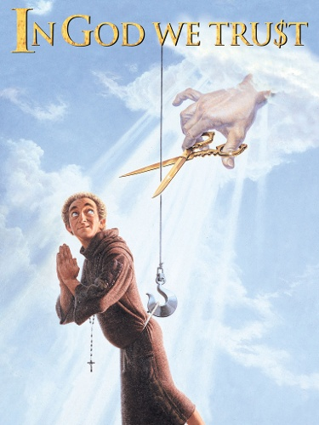
II. God removes what we trust so we'll trust him (3:1–4:1).
Notes:
The Lord takes away the props that we lean upon so we lean on him.

Slide 44
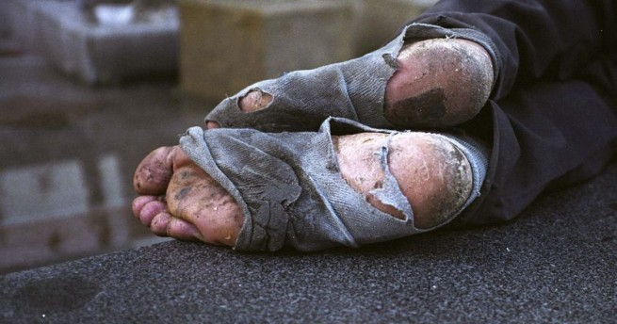
"The Lord, the LORD of Heaven's Armies, will take away from Jerusalem and Judah everything they depend on: every bit of bread and every drop of water" (3:1 NLT).

Slide 45
Leadership Vacuum (3:2-15)
Notes:
Proud men parading sin and oppressing others would bring disaster (3:2-15).

Slide 46
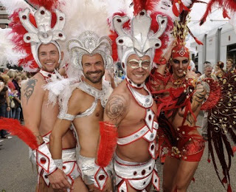
Israel Ignorant (Isa. 1:2)
"The very look on their faces gives them away. They display their sin like the people of Sodom and don't even try to hide it. They are doomed! They have brought destruction upon themselves."
(Isa. 3:9 NLT).

Slide 47
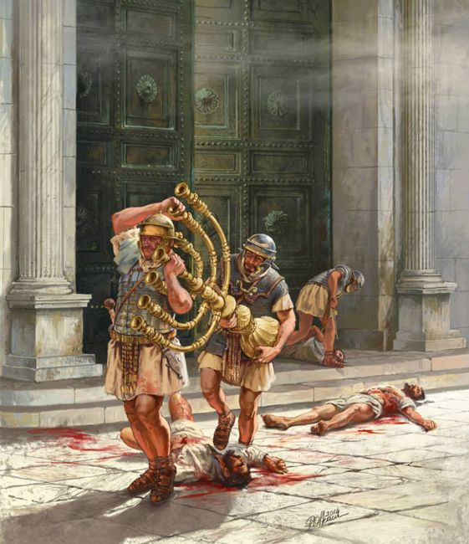
Israel Rebellious (Isa. 3:8)
"For Jerusalem will stumble, and Judah will fall, because they speak out against the LORD and refuse to obey him. They provoke him to his face"
(Isa. 3:8 NLT).
Notes:
Roman legionaries sacked the Temple during the Fall of Jerusalem in AD 70.
Jerusalem will fall yet again due to sin (Zech. 14:1).

Slide 48
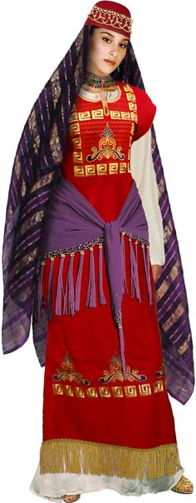
Proud women profiting from their husbands' crimes would be shamed (3:16–4:1)
Notes:
Now you can even rent a Jezebel costume!
Jezebel (9th century BCE) was queen of Israel. We know that she was a princess of Phoenicia by birth
Queen costumes on Pinterest | Queens, Eleanor Of Aquitaine
https://www.pinterest.com/takehalloween/queen-costumes/
Accessed 11 October 2015

Slide 49
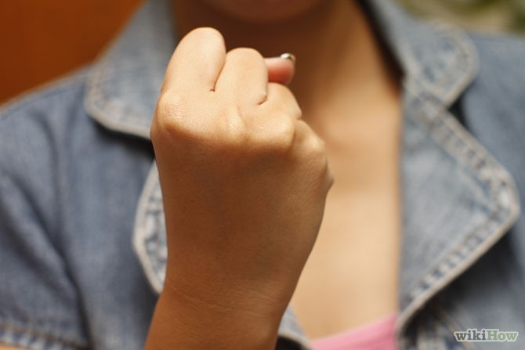
Self Confidence
Notes:
God also lovingly removes our sources of trust.
We trust our leaders (3:2-7), so God gives us bad ones—so we'll trust him instead!
We trust our own wisdom instead of his Word (3:8), so we also stagger and fall.
We trust our senses as we parade our sexual sin like Sodom (3:9), and also bring disaster on ourselves.
We trust our laws that allow us to crush people (3:15) even as Planned Parenthood crushes babies and sells their parts right now.

Slide 50
Why would God make life hard for his own people?
Notes:
Why would God make life hard for his own people? The first reason he allows things to get bad is…

Slide 51
Replace your self-confidence
with God-confidence
Our Main Idea

Slide 52
I. Our pride leads us to self-confidence (2:6-22).

Slide 53
II. God removes what we trust so we'll trust him (3:1–4:1).

Slide 54
So how do you replace your self-confidence with God-confidence?
Pride's
Disguises

Slide 55
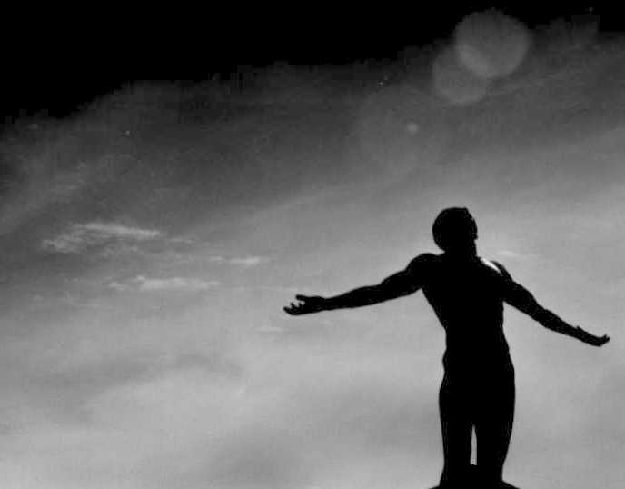
So how do you replace your self-confidence with God-confidence?
Be humble.
Give God credit.
Give others credit.
Notes:
Give God credit (He is Creator so there is no "self-made man").
Give others credit (there is no "turtle climbing up the fencepost").
Listen to others (Susan helped me to show humility).

Slide 56
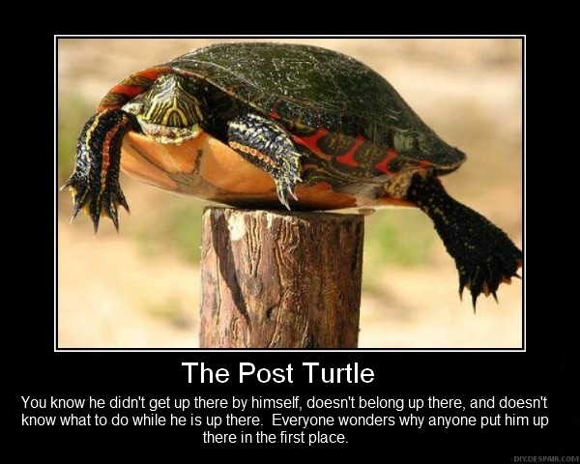
Turtle on a fencepost
He didn't get there himself.

Slide 57
So how do you replace your self-confidence with God-confidence?
Be humble.
Give God credit.
Give others credit.
Listen to others.
Be encouraged.
Notes:
Give God credit (He is Creator so there is no "self-made man").
Give others credit (there is no "turtle climbing up the fencepost").
Listen to others (Susan helped me to show humility).

Slide 58
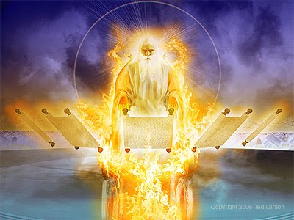
"Tell the godly that all will be well for them. They will enjoy the rich reward they have earned!" (3:10 NLT).
Notes:
God hasn't settled his books yet.

Slide 59
Black

Slide 60
OT Preaching link at BibleStudyDownloads.org
Get this presentation and script for free!
Notes:
OT Preaching (op)

